Slide 1
Infiltration Evapotranspiration and Soil Water Processes

Slide 2
Lecture Goals
Identify the factors, such as soil type, moisture content, vegetative and surface cover, and time, that affect the cumulative infiltration and infiltration rates.
Define the following terms:
Moisture content:
Gravimetric
Volumetric
Saturated
Pore Volume
Field Capacity
Available Water
Wilt Point
Discuss empirically and theoretically models for cumulative infiltration and infiltration rates via the Horton, Phillips and Green-Ampt equations.
Discuss Darcy’s Law for simple saturated flow scenarios.
Conduct a soil water balance

Slide 3
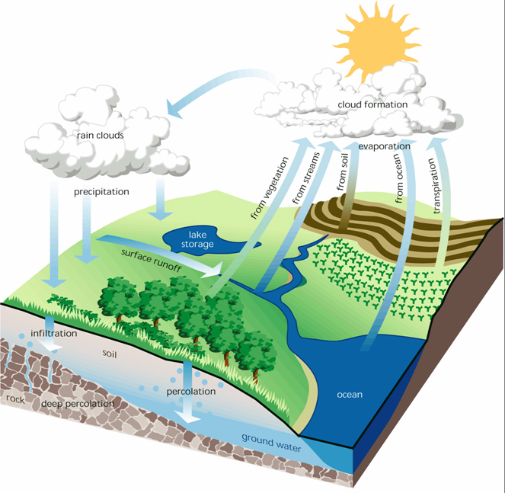

Slide 4
Definitions
Water Content
Gravimetric
Volumetric
Porosity
Degree of Saturation
Bulk Density
Particle Density
Specific Gravity
Field Capacity
Permanent Wilt Point
Available Water
Hygroscopic Water
Capillary Water
Gravity Water

Slide 5
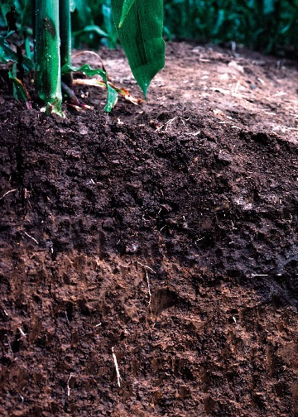
Soil Water Terms
air
pore
volume
water
solids
0
pore volume (voids)
0.3 – 0.5
solids
1.0
porosity
0.3 – 0.5
0
PWP
FC
oven dry
saturated
-15 bars
-0.3 bars
Hygroscopic water
Plant Available Water
Drainage

Slide 6
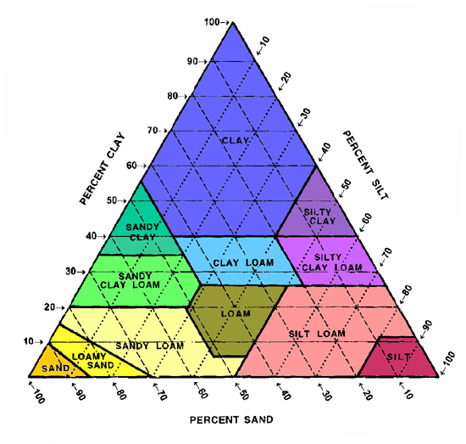
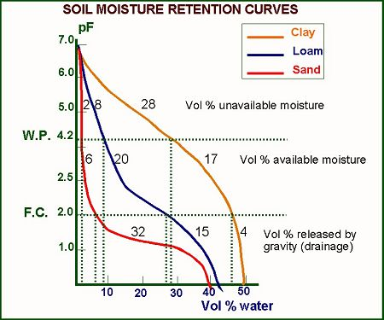
Soil Textural
http://www.nrcs.usda.gov/wps/portal/nrcs/detail/soils/survey/?cid=nrcs142p2_054167

Slide 7
Water Movement in the Soil
https://www.youtube.com/watch?v=cC7SPH2KEY4

Slide 8
Soil Water Balance
ET tree
Interception
Precipitation
Irrigation
ET grass
Surface Runoff
Storage
INFILTRATION
Effective Root Zone
Infiltration
Drainage
Storage
Effective Root Zone
Upward Flux?
Water Table
Drainage

Slide 9
Field Water Balance
Inflows – Outflows = ΔStorage
Inflows = Rainfall (R), Irrigation (I), Upward Flux (assume = 0)
Outflows = Runoff (RO), Drainage (D), Evapotranspiration (ET)
ΔStorage = WC_{i} – WC_{i-1}
R + I – RO – D – ET = WC_{i} – WC_{i-1}

Slide 10
Effective Rainfall (Precipitation)
Portion of rainfall that contributes to ET.
Pe = P – RO – D
Revised water balance
Pe + I – ET = ΔWC
At steady state (long term estimates):
ΔWC = 0
I = ET - Pe

Slide 11
Infiltration
The movement of water across the air-soil surface interface or the entry of water into the soil surface.
affected by conditions above and below the soil surface.
Infiltration is one of the most heavily researched components of the hydrologic cycle but remains the most difficult component to quantify.

Slide 12
Infiltration
Four Zones”
Saturated Zone
Transition Zone
Transmission Zone
Wetting Zone

Slide 13
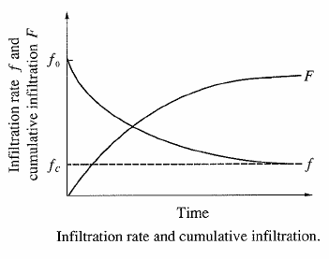
Infiltration
Infiltration rate
Rate at which water enters the soil at the surface (in/hr or cm/hr)
Cumulative infiltration
Accumulated depth of water infiltrating during given time period

Slide 14
Infiltration
Governed by:
Effects of gravity
Effects of capillary forces
Concerned with:
Saturated systems (i.e. pond liners)
Unsaturated systems (i.e. fields, lawns).

Slide 16
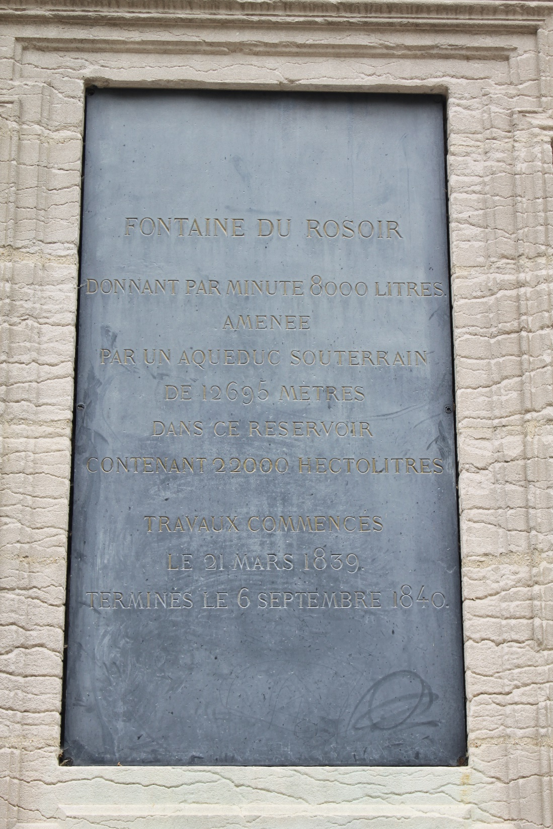

Slide 17
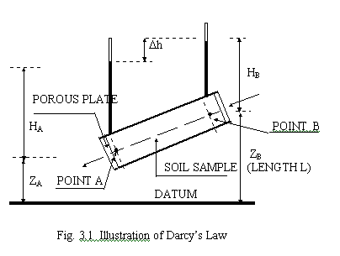
Saturated Systems - Darcy’s Law
Q = flow rate (L³/t)
K = sat. hydraulic conductivity
ΔH = H₂-H₁ = change in hydraulic head (L)
L = length of flow path (L)
A = cross sectional area
q = Darcy flux (L/t)

Slide 18
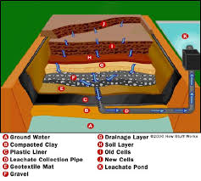
Composite Conductivity
Where
L_{T} = total length of flow path
L_{i} = length of the ith flow path
K_{sati} = conductivity of the ith layer

Slide 19
Factors Affecting Infiltration

Slide 20
Factors Affecting Infiltration
soil texture
soil organic matter and chemical content
soil density
surface cover
depth of surface ponding (surface roughness)
capillary action
initial soil moisture conditions
surface sealing
macropore density and size
rainfall intensity
subsurface conditions

Slide 21
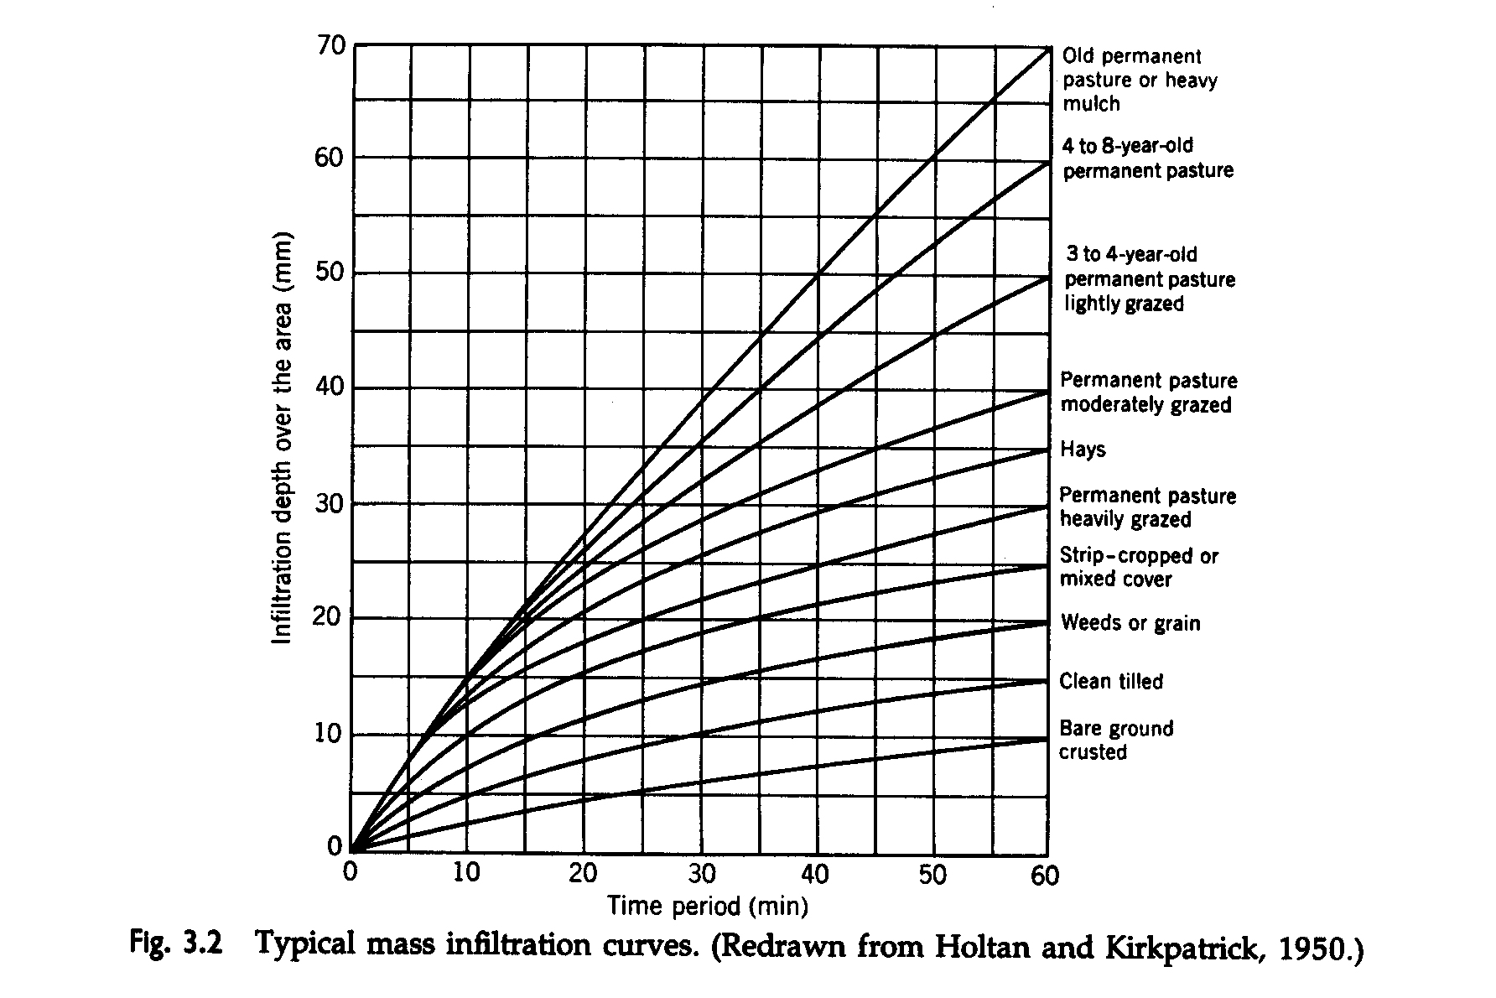
0
0

Slide 22
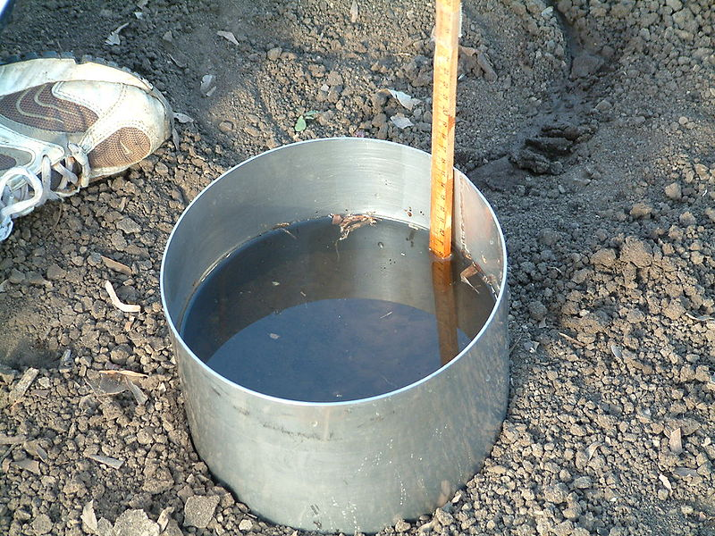
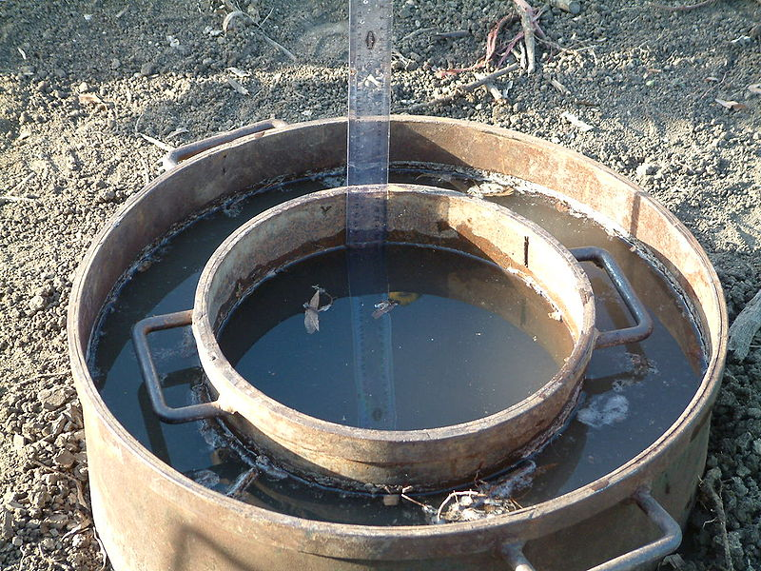
Infiltrometers
Single Ring
Double Ring
http://en.wikipedia.org/wiki/Infiltrometer

Slide 23
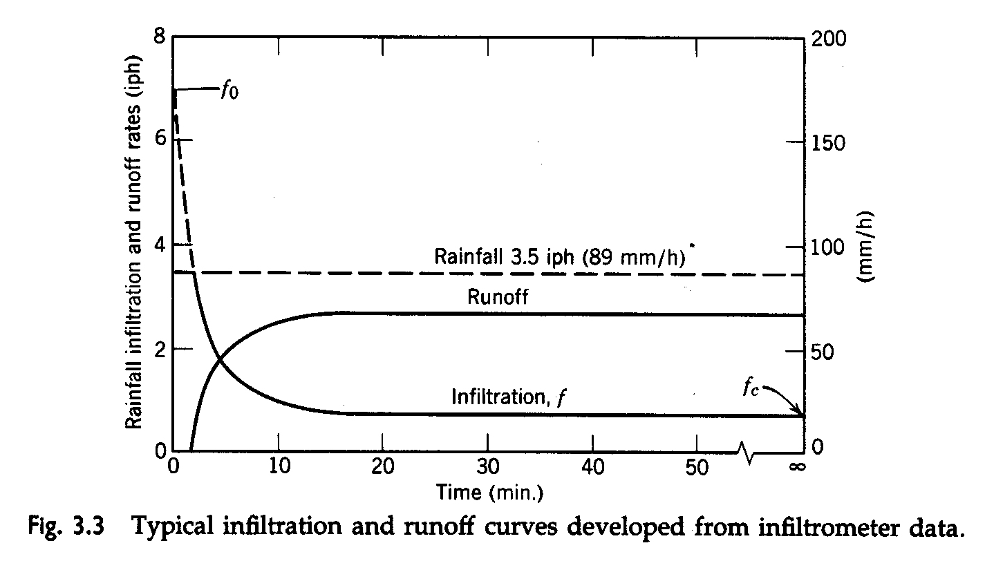

Slide 24
Unsaturated Sytems – Predicting Infiltration
Horton Equation
Empirical constants with lack of physical basis
Green-Ampt Equation
Most popular physical based equation
Phillips/Richards Equation
Darcy’s Law for unsaturated flow
Very difficult partial differential equation
Numerical and analytical solutions for special cases

Slide 25
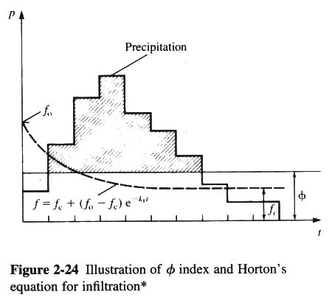
Horton Equation
f = f_{c} + (f_{o} - f_{c})e^{-Kt}
f = Horton infiltration (L/t)
f_{c} = steady state infiltration rate (L/t)
f_{o} = initial infiltration rate (L/t)
K = empirical constant (1/t)
t = time (t)

Slide 26
Green-Ampt Equation
Dp
f = infiltration rate (L/t)
K = hydraulic conductivity of the wetted part of the soil
H_{o} = depth of water ponding on the soil surface
L = depth of the wetting front below the surface
S_{w} = effective suction at the wetting front
Wetting Front
Ksat
θsat
Datum

Slide 28
Lecture Goals
Understand several empirical and physically based models for predicting evaporation from climatological data and evaporation pans.
Predict evapotranspiration of crops by calculating evaporation from nearby water bodies and transpiration from well-watered crops.

Slide 29
Read and Explain Pairs
What is ET?
http://www.ksre.ksu.edu/bookstore/

Slide 30
What is evapotranspiration (ET)?
Why is understanding ET important?
What methods (balance types) can be used to calculate ET?
What are the primary equations used for determining ET?
How does ET affect soil water availability?
Define Field Capacity (FC):
Define Available Water (AW):
Define Wilt Point (WP):
Define gravitational water:
Define soil porosity:
Define saturated water content:

Slide 31
Evaporation / Transpiration
Evaporation
The transfer of liquid water into the atmosphere.
Driven by solar energy.
Dependent on mass transfer relationships.
Transpiration
Process through which water vapor passes into the atmosphere through plant tissue.

Slide 32
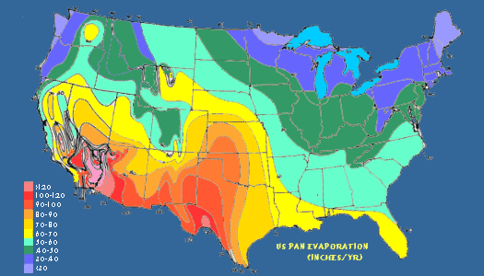

Slide 33
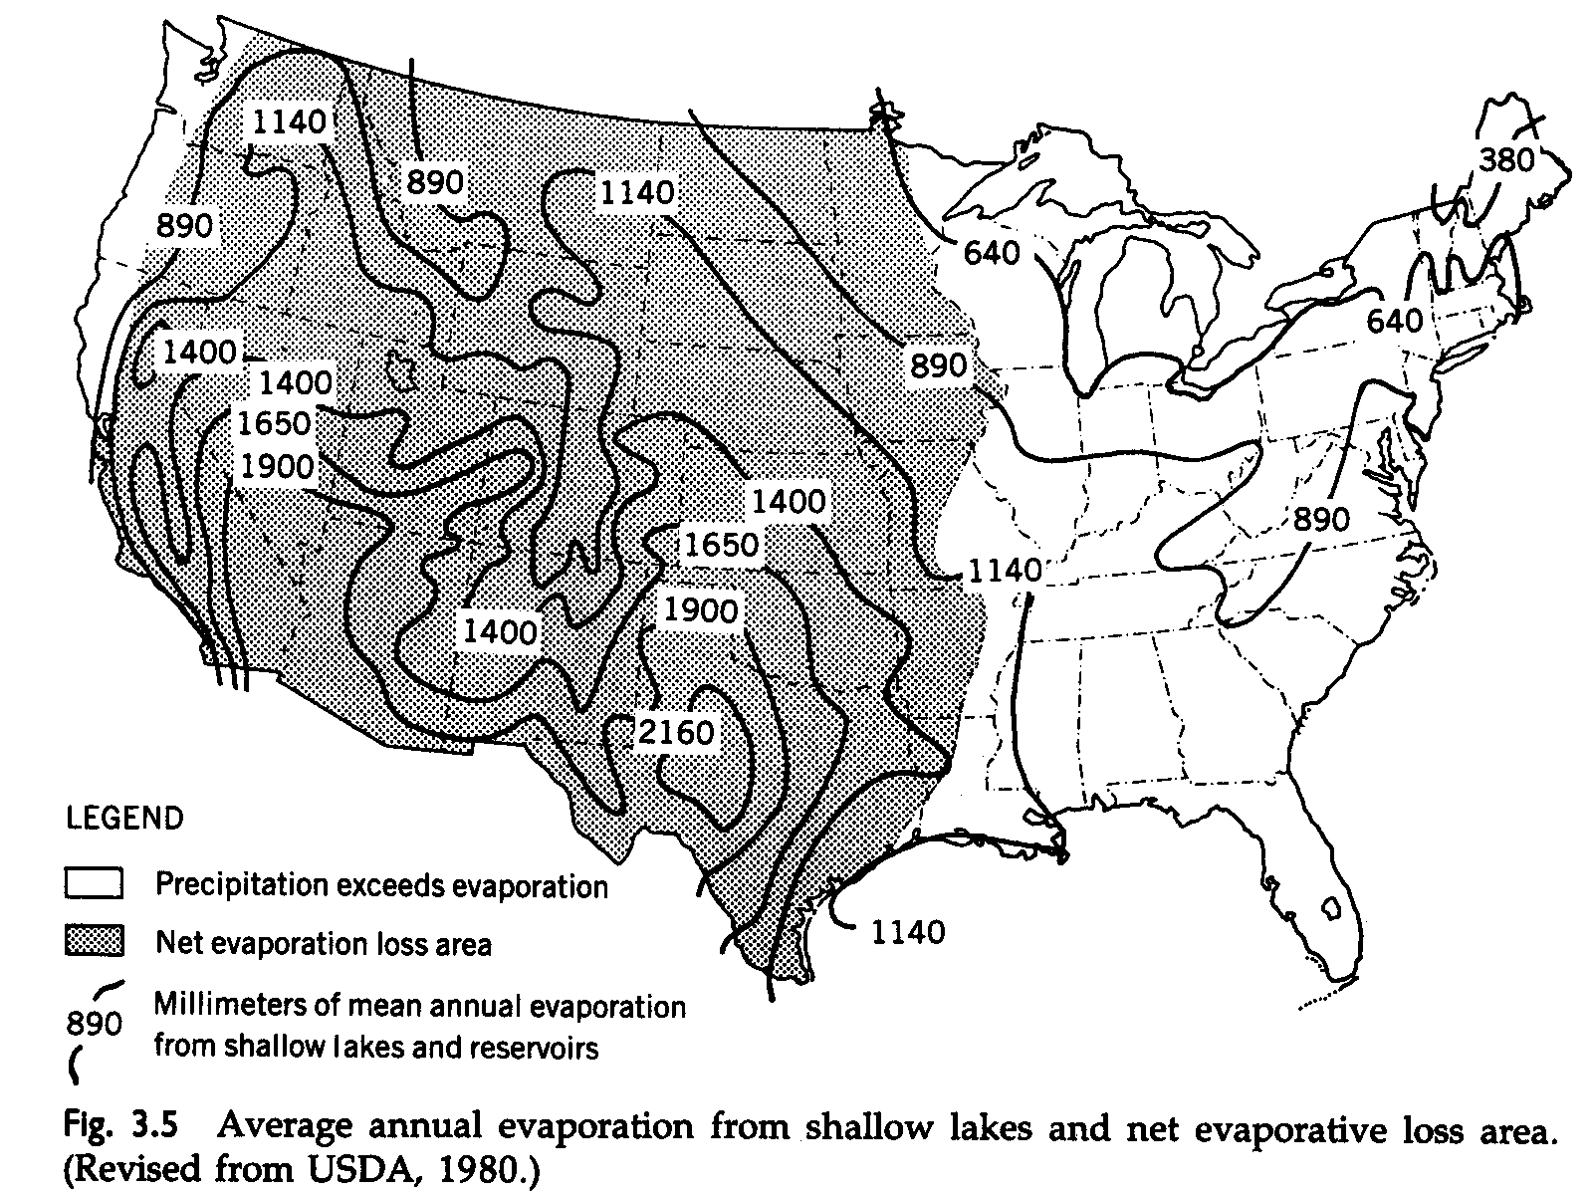

Slide 34
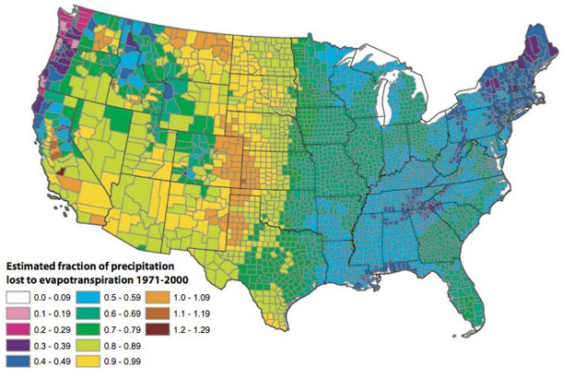

Slide 35
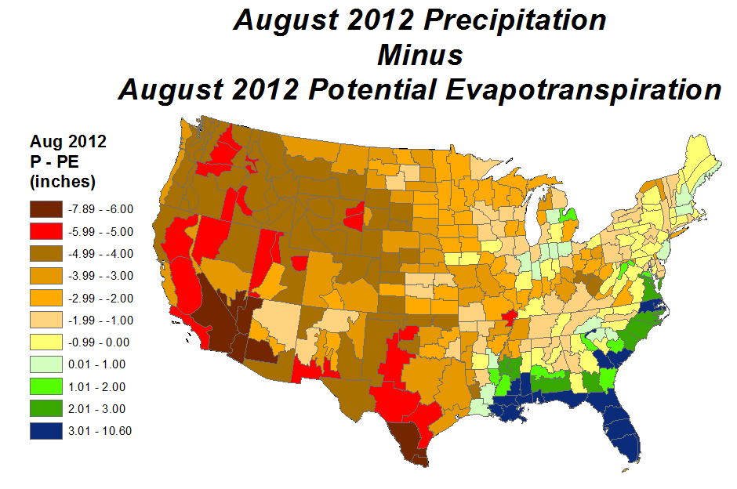

Slide 36
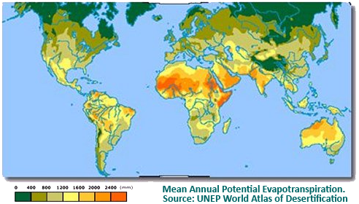

Slide 37
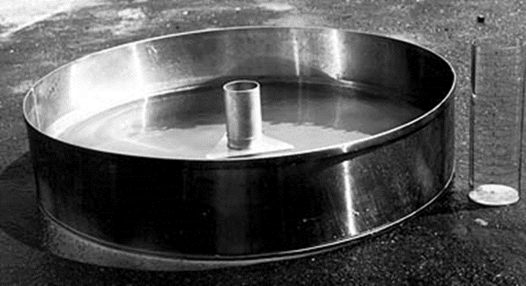
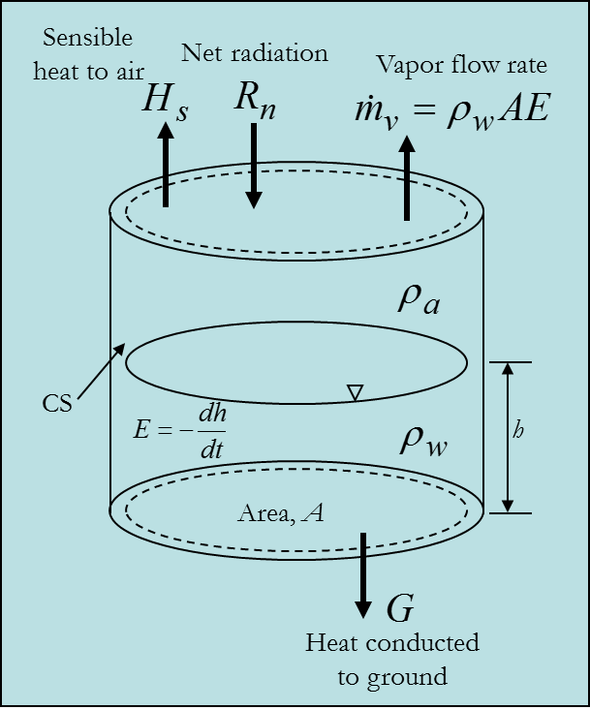
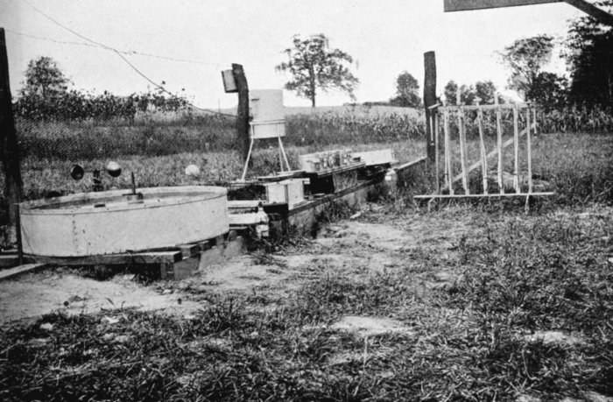
Pan Evaportion – Standard Class A Pan
National Weather Service Class A type
Installed on a wooden platform in a grassy location
Filled with water to within 2.5 inches of the top
Evaporation rate is measured by manual readings or with an analog output evaporation gauge

Slide 38
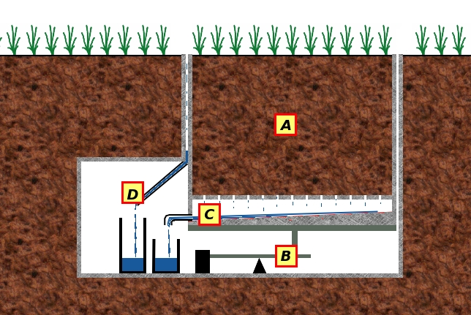
ET Measurement
Weighing Lysimeter
A = soil media
B = scale
C = flow through
D = precipitation

Slide 39
Prediction Methods
Mass Transfer
i.e. Thornthwaite Holzman
Based on variations of Fick’s Law
A vapor concentration transport model
Energy Balance
Most practical methods (i.e. Penman)
Empirical Radiation Methods
i.e. Blaney-Criddle and Jensen-Haise
Combination Methods
i.e. Penman Montheith (Energy Balance-Mass Transfer)

Slide 40
Evapotranspiration
Main factor controlling soil moisture
Significant effect on infiltration and runoff.
Greatest during the growing season.
Estimations important for continuous simulation models.
Not important for single event analysis.

Slide 41
Penman-Monteith Equation
ETo = Reference ET for a well watered grass (mm d⁻¹),
Δ = slope of the saturation vapor pressure curve (kPa/°C)
γ= psychrometric constant (kPa/°C)
Rn = net radiation (MJ m⁻² d⁻¹)
G = heat flux density to the soil (MJ m⁻² d⁻¹)
U2 = average wind speed at 2 m (m/s)
e_{s} = mean saturated vapor pressure (kPa)
e_{a} = mean actual vapor pressure (kPa)
Cd and Cn related to crop (Cn=900; Cd=0.34 for grass)

Slide 42
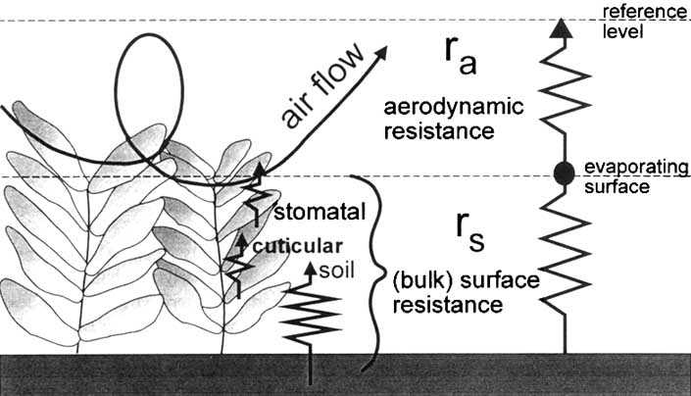
Physics of ET

Slide 43
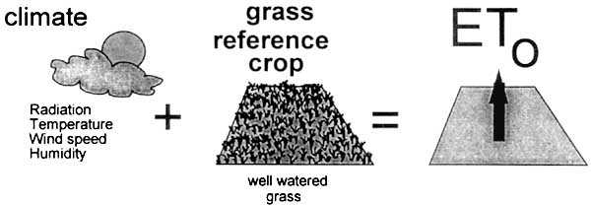
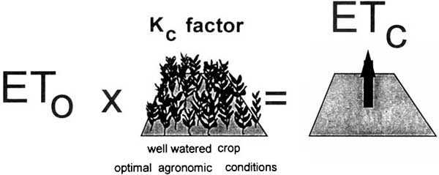
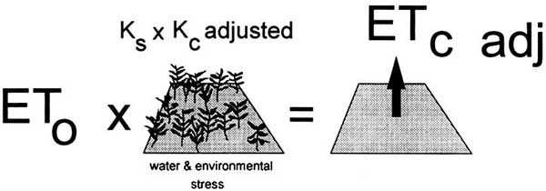

Slide 44
Evapotranspiration
ET_{c} = ET_{ref} Kc Ks
ET_{c} = Actual crop ET
ET_{ref}= Reference ET
ETr = alfalfa
ETo = grass
Kc = Crop Coefficient
Ks = Soil Water Coefficient

Slide 45
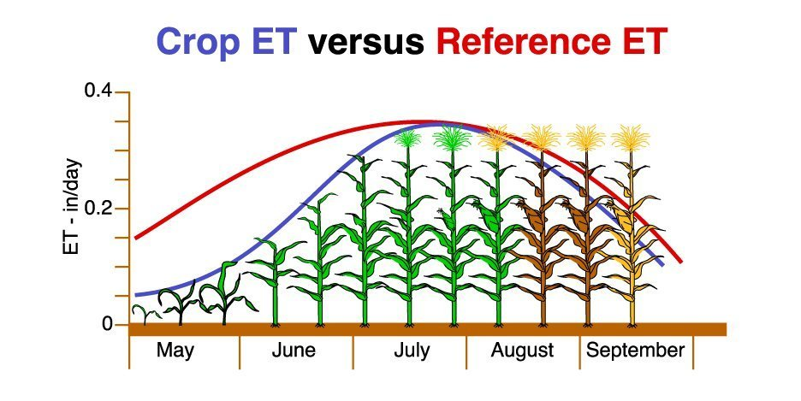

Slide 46
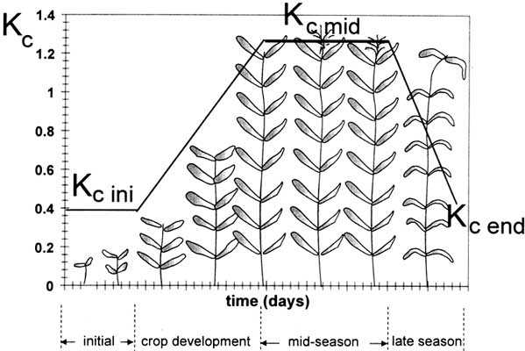
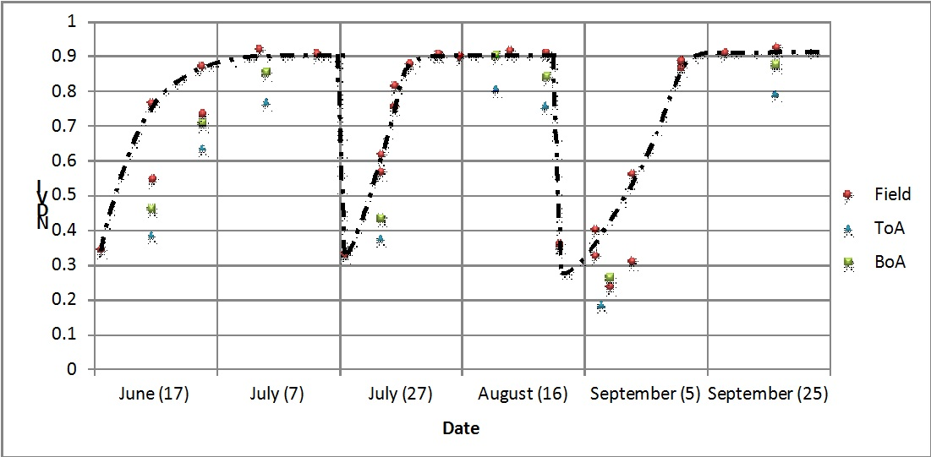
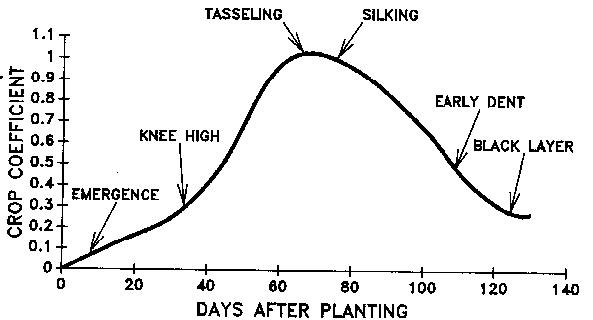
Crop Coefficients

